Slide 1
Fake News Detection Using Machine Learning
Submitted to:
Mrs. Kamini Maheshwari
Dr. Divakar Singh
Presented by:
Sonali Mahavar
Rupali Patel
Mansi Mittal
Sandhya Rani Mourya
Girraj Yadav

Slide 2
Content
Introduction
Prerequisites
Aims and objective
Literature survey
Project description
Expected outcomes
conclusion

Slide 3

Introduction
Fake news has been around for decades and is not a new concept. However, the dawn of the social media age has aggravated the generation and circulation of fake news many folds. Fake news can be simply explained as a piece of article which is usually written for economic, personal or political gains.
Many scientists believe that fake news issue may be addressed by means of machine learning and artificial intelligence . Detection of such unrealistic news articles is possible by using various NLP techniques, Machine learning, and Artificial intelligence

Slide 4
Prerequisites
Installation of following libraries:
Numpy
Pandas
Sklearn
Installation of Jupiter lab
30MB space for dataset
https://drive.google.com/file/d/1er9NJTLUA3qnRuyhfzuN0XUsoIC4a-_q/view

Slide 5

Aims and Objective
Fake news spreads like a wildfire and this is a big issue in this era. You can learn how to distinguish fake news from a real one. We can use supervised learning to implement a model.
The main objective is to generate a model that can discriminate between “fake” and “true” news articles when it is trained with a certain dataset

Slide 6
Literature survey
Before the era of digital technology, it was spread through mainly yellow journalism with focus on sensational news such as crime, gossip, disasters and satirical news (Stein-Smith 2017). The prevalence of fake news relates to the availability of mass media digital tools (Schade 2019). Since anyone can publish articles via digital media platforms, online news articles include well researched pieces but also opinion-based arguments or simply false information (Burkhardt 2017)
Comments on fake news sometimes fuel its ‘credibility’ which can lead to rapid sharing resulting in further fake news (Albright 2017)Clickbait is another tool encouraging the spread of fake news. More clicks on the advert means more money (Chen, Conroy, and Rubin 2015a).
A machine learning approach called the rumor identification framework has been developed that legitimizes signals of ambiguous posts so that a person can easily identify fake news (Sivasangari, Anand, and Santhya 2018)
Twitter has developed a possible solution to identify and prevent the spread of misleading information through fake accounts, likes and comments (Atodiresei, Tănăselea, and Iftene 2018) - the Twitter crawler.

Slide 7
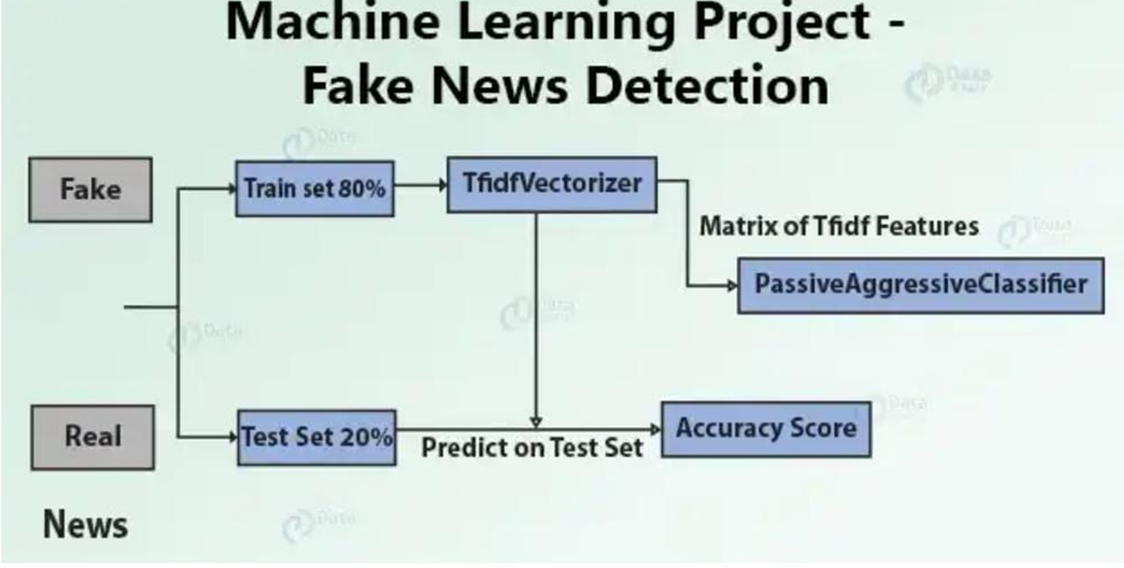
Project description
This advanced python project of detecting fake news deals with fake and real news. Using sklearn, we build a TfidfVectorizer on our dataset. Then, we initialize a PassiveAggressive Classifier and fit the model. In the end, the accuracy score and the confusion matrix tell us how well our model fares.

Slide 8
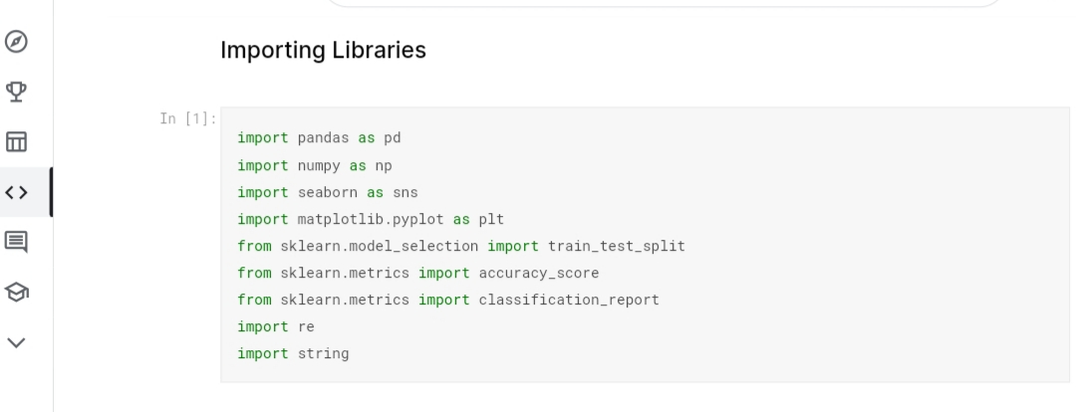
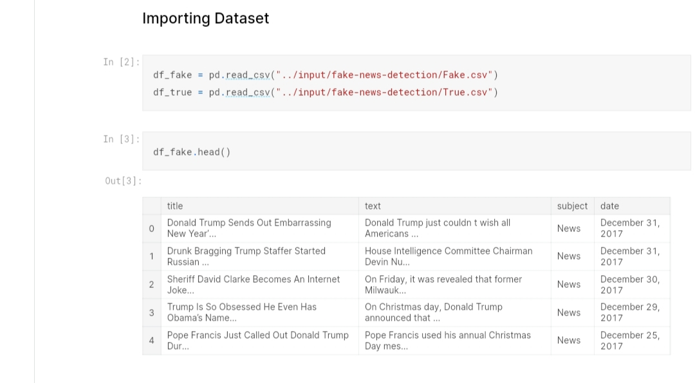
Make necessary imports:
Read the data into a DataFrame

Slide 9
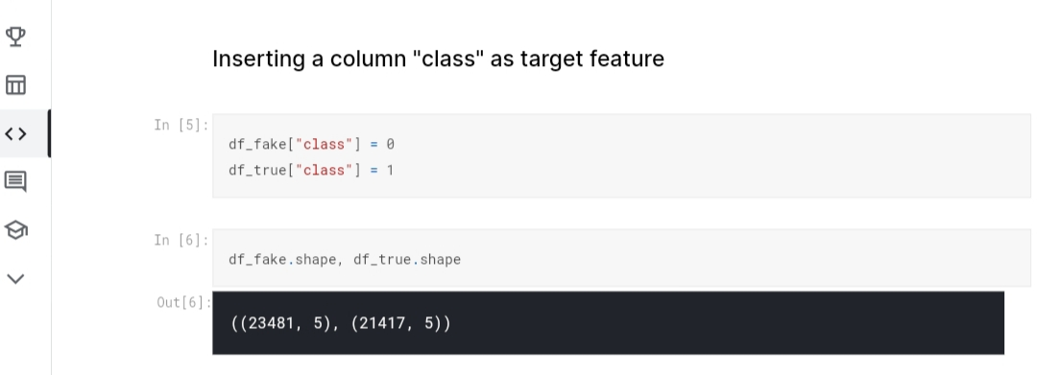
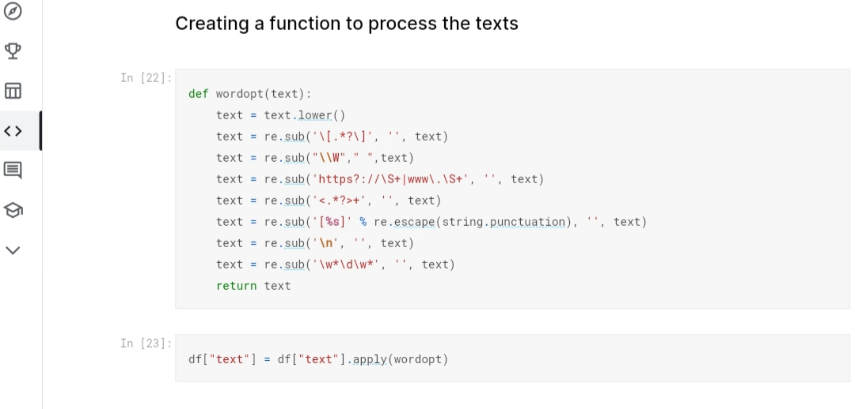
Class as target feature
Text Processing

Slide 10
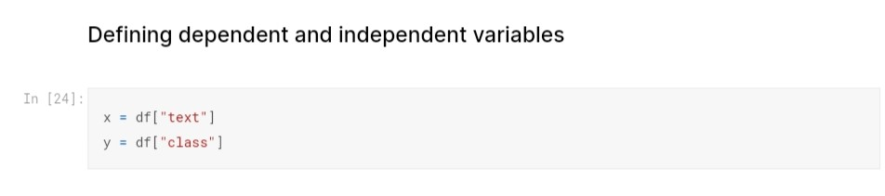
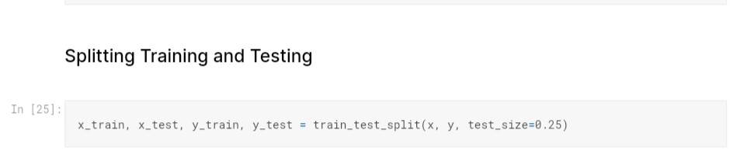
Defining dependent and independent variables
Splitting training and testing

Slide 11
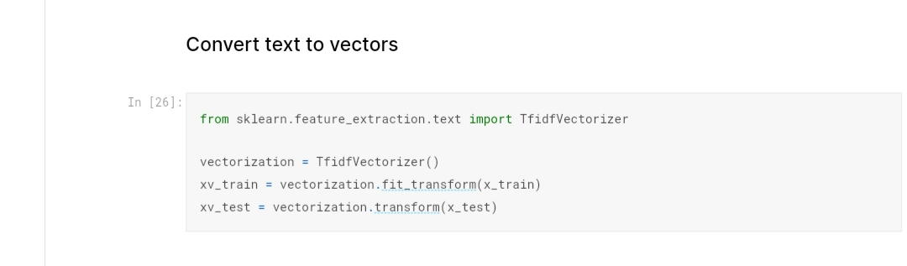
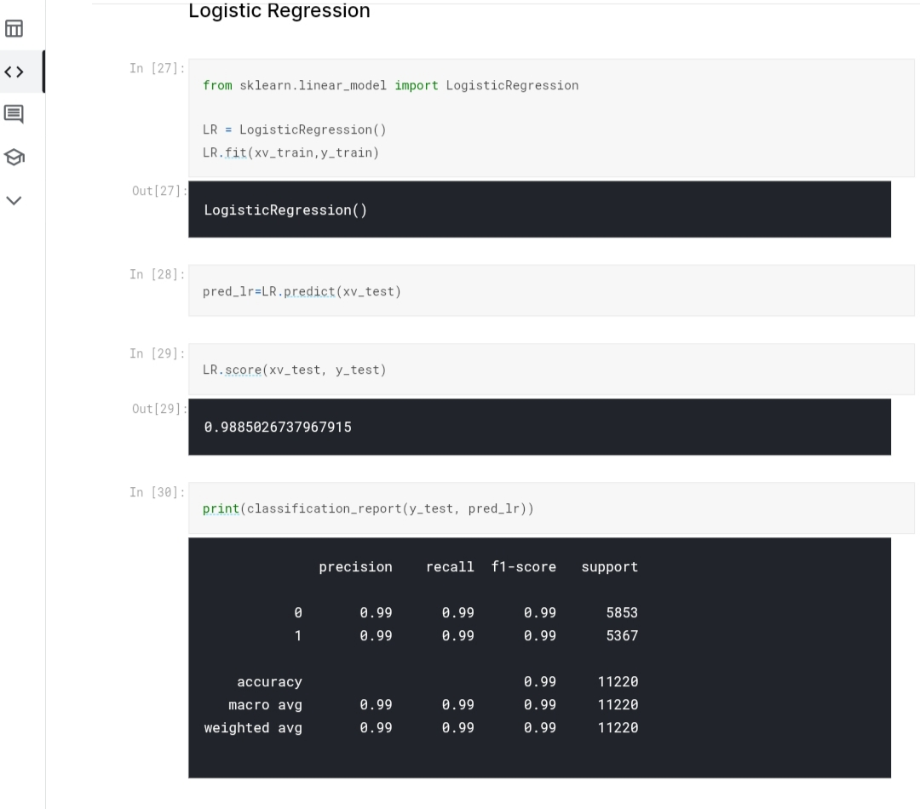
Initialize a TfidfVectorizer
Initialize Logistic Regression

Slide 12
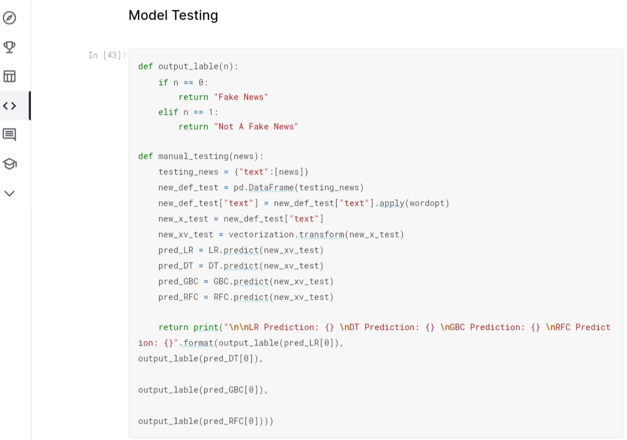
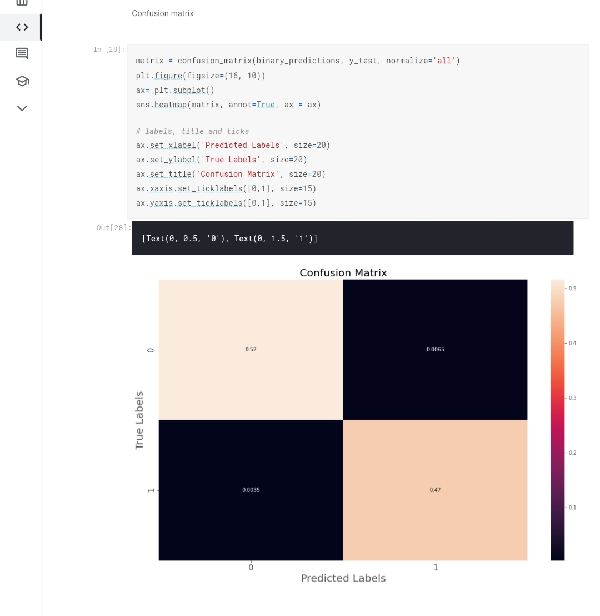
Model Testing
Finally, let’s print out a confusion matrix to gain insight into the number of false and true negatives and positives.

Slide 13
Expected outcome
The model must efficiently distinguish between true news and fake news with maximum accuracy.
We take a dataset, implemented a TfidfVectorizer, initialized a logistic regression , and find the expected result. At the end we obtain an accuracy of 92.82% in magnitude.

Slide 14

Conclusion
In the 21st century, the majority of the tasks are done online. Newspapers who were earlier preferred as hard-copies are now being substituted by applications like Facebook, Twitter, and news articles to be read online. The growing problem of fake news only makes things more complicated and tries to change or hamper the opinion and attitude of people towards use of digital technology.

Slide 15
Reference
https://data-flair.training/blogs/advanced-python-project-detecting-fake-news/
https://prezi.com/p/fh62zznlt7ay/fake-news-detection-using-machine-learning/?fallback=1

Slide 16
THANK YOU

